Slide 1
MODULE 09 Utilizing an Innovative Toolbox: Leveraging New Media and Technology
Deutsche Welle Unternehmen/CC BY-NC 2.0

Slide 2
MODULE 09 | Utilizing an Innovative Toolbox: Leveraging New Media and Technology
Share a time when technology powerfully helped you to connect with someone or something.
02

Slide 3
MODULE 09 | Utilizing an Innovative Toolbox: Leveraging New Media and Technology
How have violent extremist groups utilized technology in your context?
03

Slide 4
MODULE 09 | Utilizing an Innovative Toolbox: Leveraging New Media and Technology
How can technology (including new media) be used to build resilience to the appeal of violent extremism or counter violent extremism?
04

Slide 5
MODULE 09 | Utilizing an Innovative Toolbox: Leveraging New Media and Technology
Common goals of using technology in countering violent extremism programs:
Connecting marginalized or vulnerable people to services and opportunities.
Connecting people across dividing lines.
Building the skills of vulnerable people.
Raising awareness about radicalization and violent extremism.
Creating and sharing positive narratives.
Empowering organizations or individuals to better engage in countering violent extremism through building knowledge and skills.
05

Slide 6
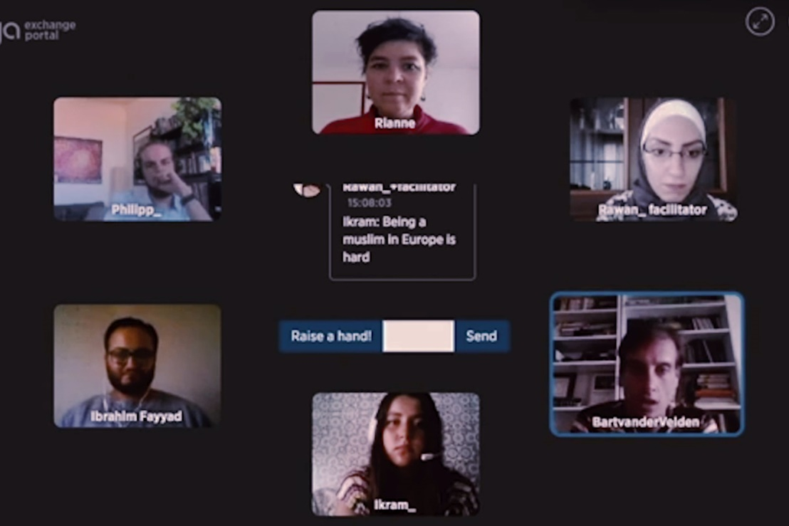
MODULE 09 | Utilizing an Innovative Toolbox: Leveraging New Media and Technology
VIDEO 23 | Erasmus+ Virtual Exchange Trailer
By: Erasmus+ Virtual Exchange
Original Link: https://youtu.be/DSW7kleimF0
Downloadable Link: The video can be downloaded here.
Arabic Subtitles:
Advanced (recommended for use with downloaded versions)
Basic (recommended for use with YouTube)
Instructions on using these subtitles are available here.
06

Slide 7
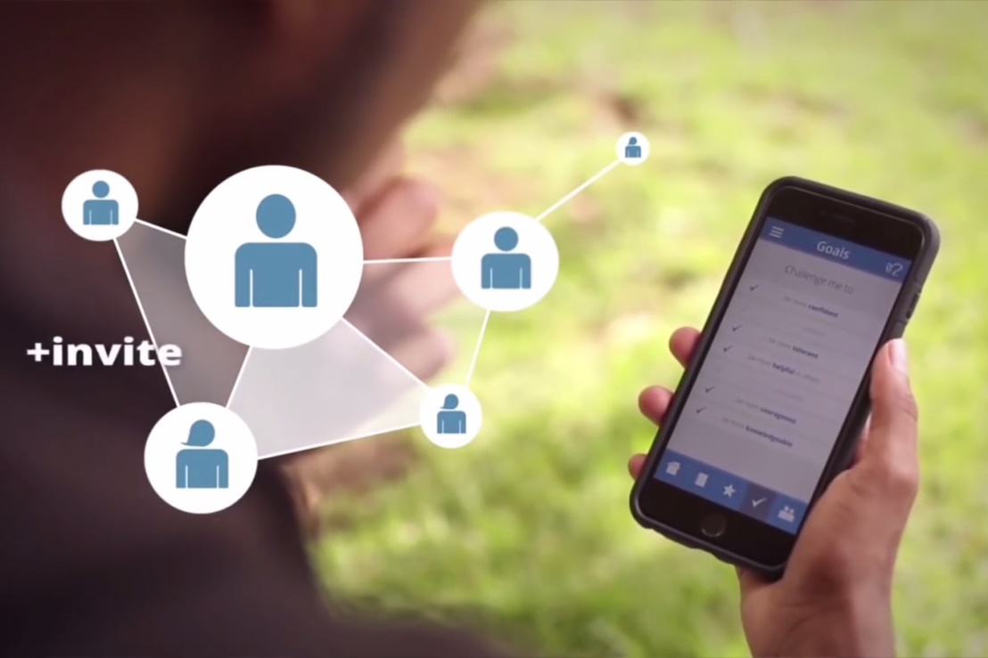
MODULE 09 | Utilizing an Innovative Toolbox: Leveraging New Media and Technology
VIDEO 24 | Peer-to-Peer: Challenging Extremism 2015
By: United States of America’s Bureau of Educational and Cultural Affairs (Department of State)
Original Link: https://youtu.be/cCrDOSsDbt8
Downloadable Link: The video can be downloaded here.
Arabic Subtitles:
Advanced (recommended for use with downloaded versions)
Basic (recommended for use with YouTube)
Instructions on using these subtitles are available here.
07

Slide 8
MODULE 09 | Utilizing an Innovative Toolbox: Leveraging New Media and Technology
Special considerations when using social media and online platforms:
Targeting your message
Use photographs or videos to grab interest
Limit yourself to only one short message per post
Use hashtags to build a broader campaign
Call your audience to action
Engage with those that interact with your posts when appropriate
08

Slide 9
MODULE 09 | Utilizing an Innovative Toolbox: Leveraging New Media and Technology
What are some of the strengths and challenges to creating your own tech platforms to counter violent extremism?
09

Slide 10
MODULE 09 | Utilizing an Innovative Toolbox: Leveraging New Media and Technology
What are some considerations practitioners should have when designing their own initiatives that use technology or when creating their own tech tools for countering violent extremism programming?
10

Slide 11
MODULE 09 | Utilizing an Innovative Toolbox: Leveraging New Media and Technology
International good practices and lessons learned on technology in countering violent extremism:
Nothing beats reality: – Counter-narratives and tech tools alone are not the only solution to preventing radicalization and recruitment
Communication is only one part of the solution: – Integrate countering violent extremism communications approaches (such as positive narratives) into the broader counter-terrorism strategies and policies
11

Slide 12
MODULE 09 | Utilizing an Innovative Toolbox: Leveraging New Media and Technology
(continued):
Engage in a multi-faceted approach: – Such as removing violent extremist content, countering misinformation, communicating your own message, and making youth more resilient through activities and education
Engage in a whole of society approach: – Including government institutions, civil society, and the private sector as well as local actors (and do not forget youth!)
Ensure consistency and coordination: – Coordinate efforts to ensure that messages are not contradicting and build on existing efforts
12

Slide 13
MODULE 09 | Utilizing an Innovative Toolbox: Leveraging New Media and Technology
What are the risks or challenges to using new media and technology?
The development and use of technology tools can be expensive and difficult.
They may require specific aspects such as an engaging and user-friendly development, specialized moderators to manage the platforms, and/or longer-term commitments to keep the platforms active. Ask yourself whether there are enough resources:
to see the development through to completion?
to ensure that it is marketed and that the tool or platform is managed and sustained after the development phase?
Technology and social media tools can also run the risk of not reaching the right audience if their design was not informed by adequate research.
13

Slide 14
MODULE 09 | Utilizing an Innovative Toolbox: Leveraging New Media and Technology
KEY TAKEWAYS
New media and technology are more likely to facilitate radicalization and violent extremism than to drive it.
Using new media and technology in countering violent extremism programming can expand reach and inspire change.
New media and technology cannot replace reality when countering violent extremism.
Creating new platforms (versus using or creating spaces on established platforms) can be difficult and costly but can also be effective.
14

