Slide 1
MODULE 08 Understanding the Role of Narratives and Media in Violent Extremism
UN Photo/Shareef Sarhan

Slide 2
MODULE 08 | Understanding the Role of Narratives and Media in Violent Extremism
When you reflect on your own life, how have your political, religious, or ethical views changed? Why did they change?
02

Slide 3
Narratives are a set of ideas, facts, perspectives, and experiences that inform the way an individual or group perceives their place in the world around them.
MODULE 08 | Understanding the Role of Narratives and Media in Violent Extremism
blend elements of historical truth with constructed storylines
resonate deeply with people’s sense of self and how they make sense of events in their own lives
can be positive or negative and function as a natural part of the human experience
03

Slide 4
MODULE 08 | Understanding the Role of Narratives and Media in Violent Extremism
How do violent extremists use narratives?
04

Slide 5
MODULE 08 | Understanding the Role of Narratives and Media in Violent Extremism
How can narratives be effectively used to prevent radicalization or recruitment or promote disengagement or deradicalization?
05

Slide 6
MODULE 08 | Understanding the Role of Narratives and Media in Violent Extremism
Kinds of narratives for countering violent extremism:
Alternative narratives: Challenge the relevance of violent extremist narratives by offering more effective and non-violent understandings of grievances as well as approaches to addressing them.
Counter narratives: Directly challenge, refute, or discredit violent extremist narratives by exposing the error in their ideologies, theology, or framing of a conflict or local issues and exposing lies and hypocrisy.
Government strategic communications: Undermine violent extremist narratives by explaining government actions and policy in ways that refute misinformation and a lack of clarity.
06

Slide 7
MODULE 08 | Understanding the Role of Narratives and Media in Violent Extremism
VIDEO 19 | You Are My Son
By: MullenLowe Group for The Colombian Ministry of Defense
Original Link: https://youtu.be/qYrofD8l1-k
Arabic Subtitles:
Advanced (recommended for use with downloaded versions)
Basic (recommended for use with YouTube)
Instructions on using these subtitles are available here.
07

Slide 8
MODULE 08 | Understanding the Role of Narratives and Media in Violent Extremism
REFLECTION QUESTIONS
Would you consider this campaign an example of a counter narrative, alternative narrative, or government strategic communications? Or does it include multiple elements? If so, which elements are examples of which category and why?
What was the goal of the campaign?
Who were the central messengers of the campaign’s message? How was the campaign an example of cooperation?
What were the different formats for the campaign?
08

Slide 9
MODULE 08 | Understanding the Role of Narratives and Media in Violent Extremism
Would the campaign in Colombia have been as successful if it did not center around the mothers? Why or why not?
09

Slide 10
Deutsche Welle Unternehmen/CC BY-NC 2.0
MODULE 08 | Understanding the Role of Narratives and Media in Violent Extremism
Guidelines for implementing effective narrative campaigns
Understand and assess the relevant drivers of violent extremism
Identify the target audience
Identify the explicit or implicit violent extremist narratives that resonate with the target audience
Set clear goals and objectives of the campaign
Determine effective messengers
10

Slide 11
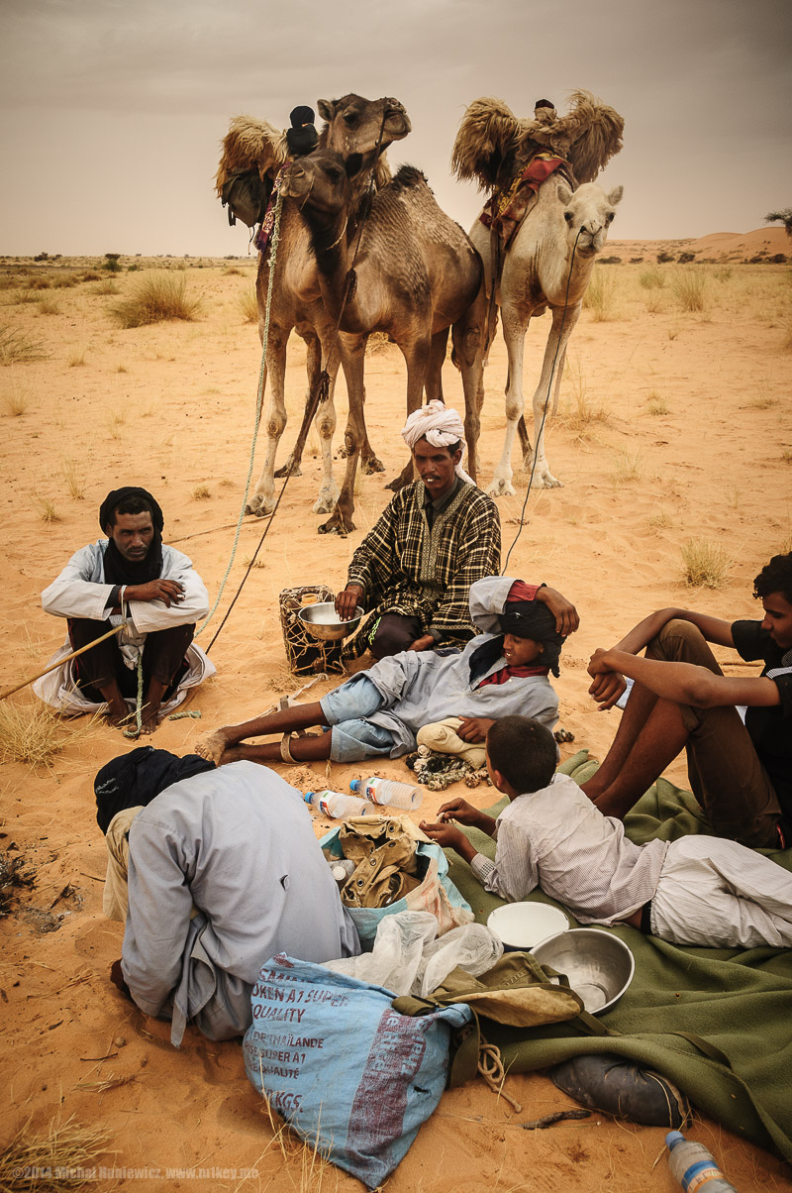
Michał Huniewicz/CC BY 2.0
MODULE 08 | Understanding the Role of Narratives and Media in Violent Extremism
Guidelines for implementing effective narrative campaigns
Develop the content and logic to the messages
Identify the formats where the messages will be shared
Develop a strategy to disseminate the messages and how to connect them to actions or programs
Evaluate and assess the impact of the campaign
Adjust the campaign as necessary and continue if needed
11

Slide 12
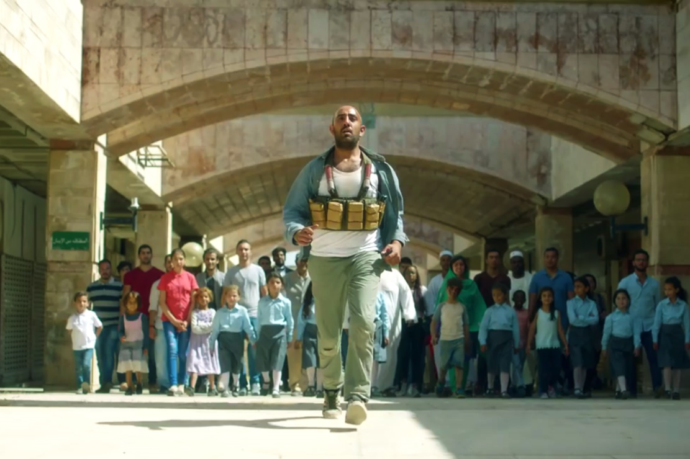
MODULE 08 | Understanding the Role of Narratives and Media in Violent Extremism
VIDEO 20 | Zain Ramadan Commercial
By: Zain
Original Link: https://youtu.be/U49nOBFv508
12

Slide 13
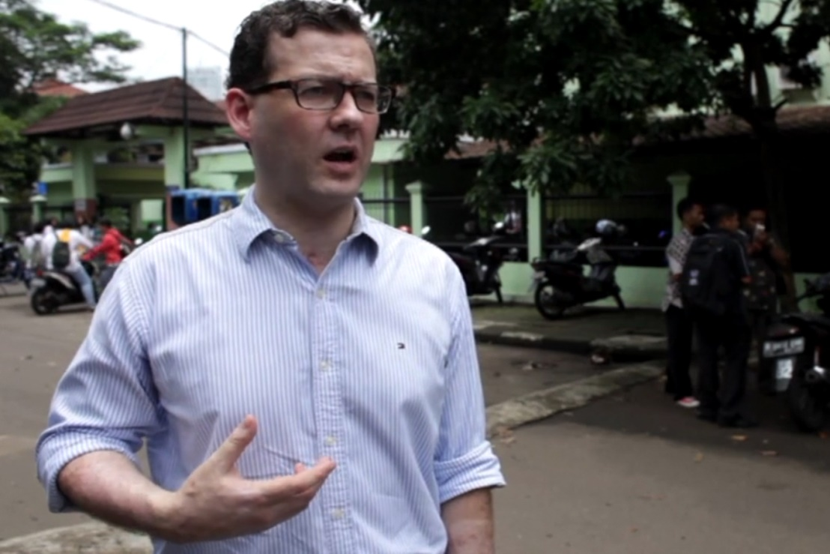
MODULE 08 | Understanding the Role of Narratives and Media in Violent Extremism
VIDEO 21 | Empowering Terrorism Victims in Indonesia
By: The Victims' Voices Initiative
Original Link: https://vimeo.com/310277294/037b2437cd
13

Slide 14
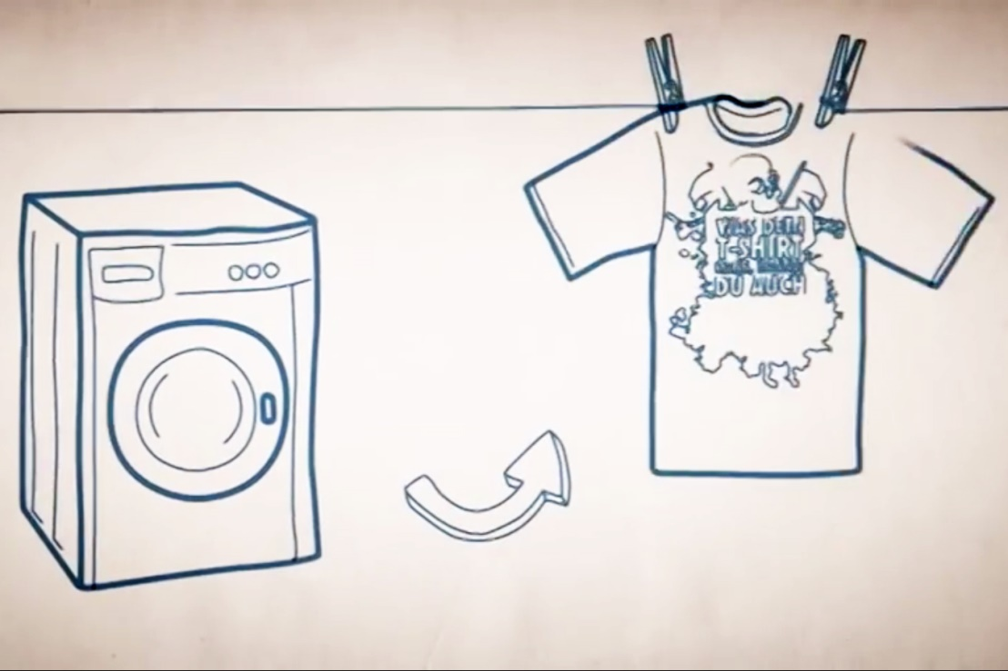
MODULE 08 | Understanding the Role of Narratives and Media in Violent Extremism
VIDEO 22 | Trojan T-Shirt
By: EXIT-Germany
Original Link: https://youtu.be/CSIbsHKEP-8
Arabic Subtitles:
Advanced (recommended for use with downloaded versions)
Basic (recommended for use with YouTube)
Instructions on using these subtitles are available here.
14

Slide 15
MODULE 08 | Understanding the Role of Narratives and Media in Violent Extremism
REFLECTION QUESTIONS
Do you think that the narratives in these two videos are effective? Why or why not?
What were the different mediums that are used to share these narratives? What are the strengths and challenges of using the different mediums?
Would you define the messages shared in the videos as counter narratives, alternative narratives, or government strategic communications? Why?
15

Slide 16
MODULE 08 | Understanding the Role of Narratives and Media in Violent Extremism
REFLECTION QUESTIONS
At what stage of intervention is each narrative campaign targeted to (for example, general prevention, early intervention and diversion, or deradicalization)?
Why might this campaign have been influential? Why not?
How would you measure this campaign’s success?
16

Slide 17
MODULE 08 | Understanding the Role of Narratives and Media in Violent Extremism
Good practices in using narratives:
Messenger is more important than the message. Who can best influence?
Going local with local ownership. What are the existing, effective local narratives?
Do not dismiss violent extremist grievances, but transform the way the grievances are characterized and the response to it. What is your call to action?
Reinforce community and religious norms rather than try to discredit their interpretations. How do we resonate with those at risk rather than further marginalize them?
Engage broad actors (public, private, independent, civil society) with sharing messages. How do we amplify narratives without a whole of society approach?
17

Slide 18
MODULE 08 | Understanding the Role of Narratives and Media in Violent Extremism
Risks of using narratives to counter violent extremism:
Governments may sometimes decide to prosecute those who share messages similar to those being shared by violent extremists (such as expressing grievances) rather than positively engaging with these ideas and offering alternative narratives and solutions.
The possession of violent extremist content may be illegal, which may make studying them difficult or risky.
Be careful in the use of violent extremism content when building counter narratives, which can end up spreading violent extremist narratives.
18

Slide 19
MODULE 08 | Understanding the Role of Narratives and Media in Violent Extremism
Risks of using narratives to counter violent extremism:
Marginalizing vulnerable communities by causing them to feel that their values or perspectives are being attacked, rather than listened to.
Using the wrong messenger can undermine narratives and result in campaigns losing credibility or being seen as propaganda.
19

Slide 20
MODULE 08 | Understanding the Role of Narratives and Media in Violent Extremism
KEY TAKEWAYS
Positive narratives to prevent and counter violent extremism come in many forms.
Narratives are not just media products, but both words and actions.
Effective positive narratives that help individuals and communities be resilient to violent extremism are already present in local communities.
Narratives that drive violent extremism are often promoted by groups and individuals other than violent extremist themselves.
The messengers can be more important than the messages.
20

