Slide 1
MODULE 06 Understanding and Engaging Youth in Countering Violent Extremism

Slide 2
MODULE 06 | Understanding and Engaging Youth in Countering Violent Extremism
When you were young (perhaps 18-21 years old), what was a time when you truly felt valued, listened to, or mattered to someone?
02

Slide 3
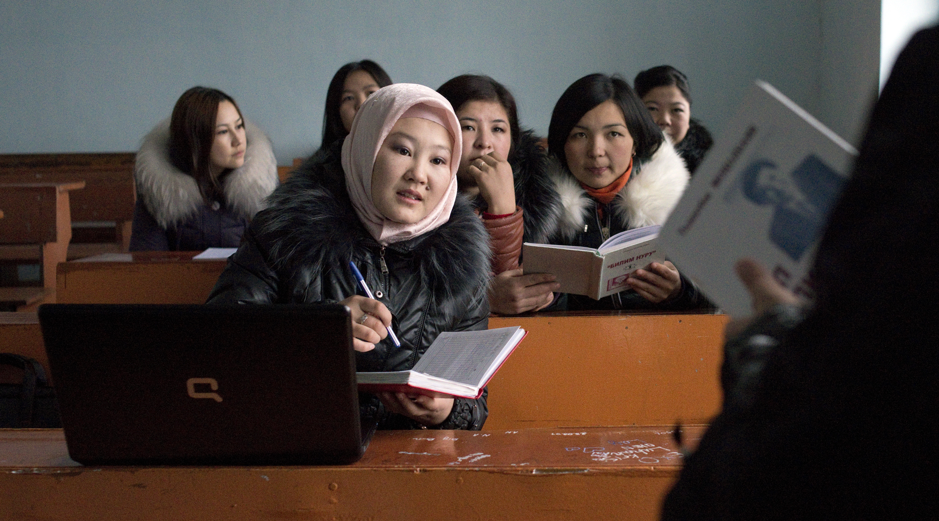
MODULE 06 | Understanding and Engaging Youth in Countering Violent Extremism
DO YOU AGREE WITH THE FOLLOWING STATEMENT?
Countering violent extremism programs are most effective when they engage youth from the community.
03

Slide 4
MODULE 06 | Understanding and Engaging Youth in Countering Violent Extremism
Why is it important to engage and support youth in countering violent extremism?
Youth are a source of potential for positive change and are credible actors for their peers.
Youth bring an added value to countering violent extremism efforts through their: – unique perspectives on issues and vulnerable youth – unique ideas and solutions to violent extremism – ability to better reach vulnerable youth
Their engagement supports their own resilience as well as that of others.
04

Slide 5
MODULE 06 | Understanding and Engaging Youth in Countering Violent Extremism
How can we engage youth in countering violent extremism?
Meet young people’s needs for respect, dignity, and agency or they may not be empowered in the ways that make them most resilient against the appeal of violent extremism.
Help young people secure their own future, such as getting an education, starting a career, or address grievances—especially when these are drivers of violent extremism.
05

Slide 6
MODULE 06 | Understanding and Engaging Youth in Countering Violent Extremism
Where can young people be included in countering violent extremism?
Youth should be involved at the 1) policy level, 2) practitioner level and 3) the grassroots level.
The United Nations Security Council Resolution on Youth, Peace, and Security (2250) recommends the following five pillars:
Participation, Protection, Prevention, Partnership, and Disengagement and Reintegration
06

Slide 7
MODULE 06 | Understanding and Engaging Youth in Countering Violent Extremism
DEGREE OF PARTICIPATION:
– Youth-initiated and shared decisions with other stakeholders
– Youth-initiated and youth-directed
– Stakeholder-initiated and shared decisions with youth
– Youth are consulted and informed
– Youth are assigned but informed
NON-PARTICIPATION:
– Youth are “tokens”
– Youth are “decoration”
– Youth are manipulated and not informed
07

Slide 8
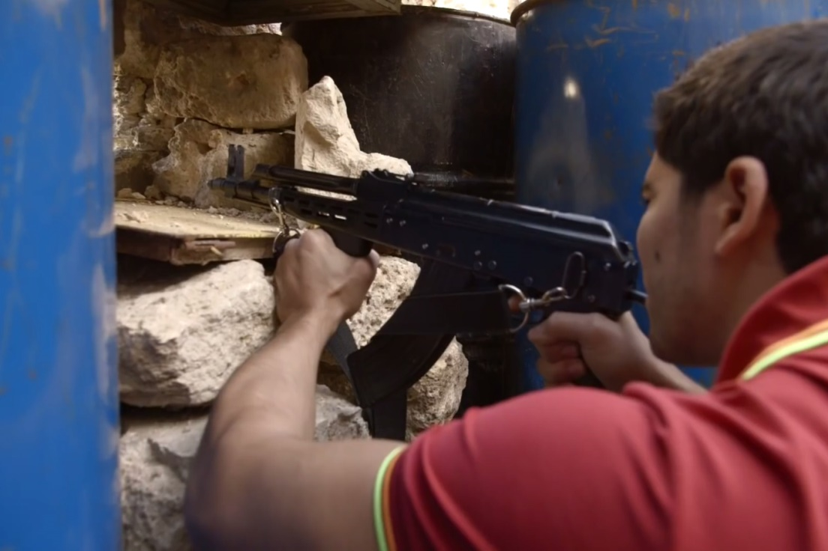
MODULE 06 | Understanding and Engaging Youth in Countering Violent Extremism
VIDEO 9 | Lebanon’s Illegal Arms Dealers
By: VICE News
1-minute clip: https://youtu.be/QGSCZM6yz3M
Original Link: https://youtu.be/XxumsOQMxLE
Downloadable Link: The video can be downloaded here.
Russian Subtitles:
Advanced (recommended for use with downloaded versions)
Basic (recommended for use with YouTube)
Instructions on using these subtitles are available here.
08

Slide 9
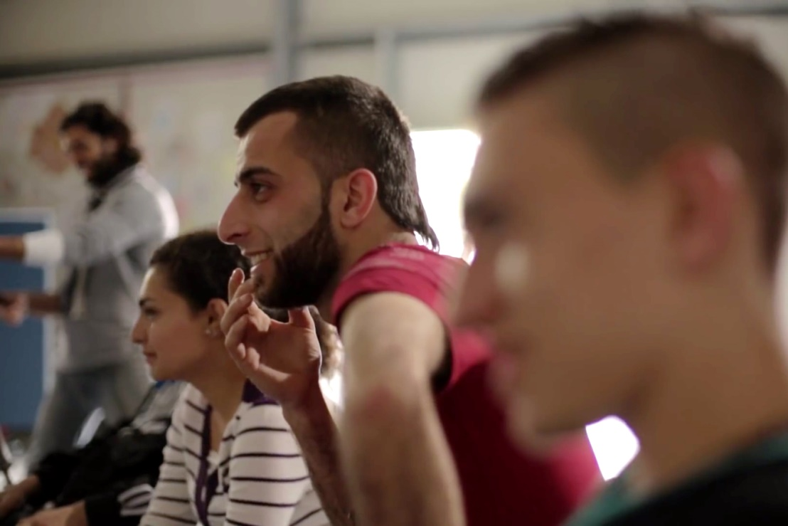
MODULE 06 | Understanding and Engaging Youth in Countering Violent Extremism
VIDEO 10 | “Love and War on the Rooftop” - The Documentary (Trailer)
By: MARCH Lebanon
Original Link: https://youtu.be/hZHz1NyuB1o
Downloadable Link: The video can be downloaded here.
Russian Subtitles:
Advanced (recommended for use with downloaded versions)
Basic (recommended for use with YouTube)
Instructions on using these subtitles are available here.
09

Slide 10
MODULE 06 | Understanding and Engaging Youth in Countering Violent Extremism
VIDEO 11 | The ‘Qahwetna’ Cultural Café (Trailer)
By: MARCH Lebanon
Original Link: https://youtu.be/jpD_-Xr1VeA
Downloadable Link: The video can be downloaded here.
Russian Subtitles:
Advanced (recommended for use with downloaded versions)
Basic (recommended for use with YouTube)
Instructions on using these subtitles are available here.
10

Slide 11
MODULE 06 | Understanding and Engaging Youth in Countering Violent Extremism
What are some commonly held ideas or stereotypes about youth in your area?
11

Slide 12
MODULE 06 | Understanding and Engaging Youth in Countering Violent Extremism
CONTRIBUTIONS
AGENCY
ASSETS
ENABLING
ENVIRONMENT
12

Slide 13
MODULE 06 | Understanding and Engaging Youth in Countering Violent Extremism
REFLECTION QUESTIONS
What did your group identify as the top three barriers to youth participating in countering violent extremism programs and activities?
What are any obstacles you might consider addressing now in your work to engage youth?
What would be the best steps or actions that could overcome these barriers that hinder the engagement of youth?
13

Slide 14
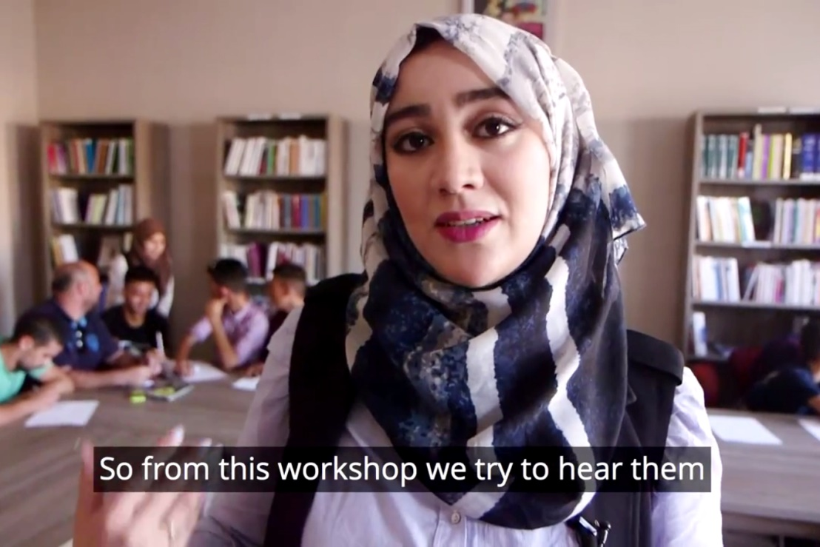
MODULE 06 | Understanding and Engaging Youth in Countering Violent Extremism
VIDEO 12 | Fatima takes a stand: A young Moroccan’s journey to stop violent extremism
By: Search for Common Ground
Original Link: https://youtu.be/fVn7XhrlUeQ
Downloadable Link: The video can be downloaded here.
Russian Subtitles:
Advanced (recommended for use with downloaded versions)
Basic (recommended for use with YouTube)
Instructions on using these subtitles are available here.
14

Slide 15
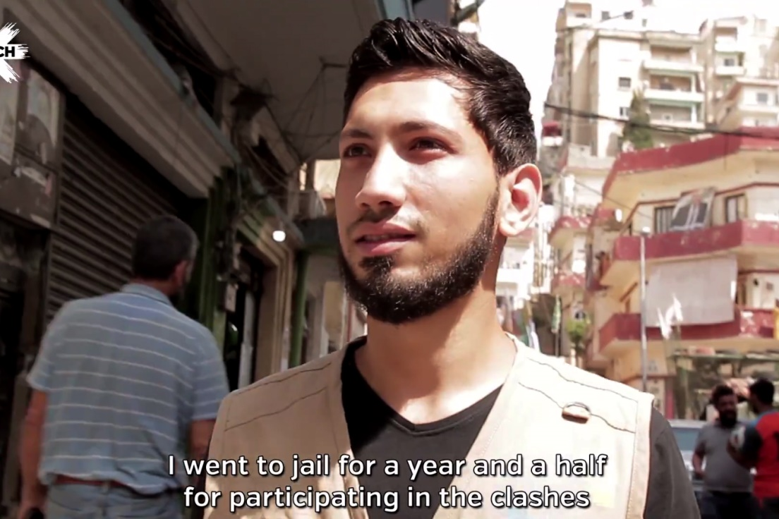
MODULE 06 | Understanding and Engaging Youth in Countering Violent Extremism
VIDEO 13 | Meet the People of Beb al-Dahab (Golden Door)
By: MARCH Lebanon
Original Link: https://youtu.be/4_xHIJ5DkT0
Downloadable Link: The video can be downloaded here.
Russian Subtitles:
Advanced (recommended for use with downloaded versions)
Basic (recommended for use with YouTube)
Instructions on using these subtitles are available here.
15

Slide 16
MODULE 06 | Understanding and Engaging Youth in Countering Violent Extremism
Potential risks from engaging youth in countering violent extremism programming:
Other countering violent extremism practitioners may not have the necessary tools or flexibility to understand young dynamics in their context or may embrace negative stereotypes of youth.
When youth are engaged, they may not be given an equal say or equal representation.
Youth may not be properly prepared for engagement or fear that they will be perceived as tools of other organizations or institutions.
Information gathered through engaging youth may be used in ways that damage the relationship or the perception of the partnership.
02
16

Slide 17
MODULE 06 | Understanding and Engaging Youth in Countering Violent Extremism
KEY TAKEWAYS
Countering violent extremism efforts will not be as effective if they do not meet the needs of young men and women.
Youth and youth leaders need to be given respect, dignity and agency in order for them to be partners and leaders in countering violent extremism.
Youth must be actively engaged in all levels of countering violent extremism as critical, trusted partners and leaders.
Youth are already working in the countering violent extremism field, and their efforts should be mapped and successful efforts should be supported.
17

Slide 18
MODULE 06 | Understanding and Engaging Youth in Countering Violent Extremism
KEY TAKEWAYS
Youth often organize and operate differently, which may create challenges to collaboration as well as opportunities to make programming more effective.
The level of youth participation increases as youth are able to have a greater say in the design, implementation, monitoring, and evaluation of programs.
Barriers may need to be removed and youth may need to be provided with additional resources in order for them to be able to engage in activities or lead programs.
18

