Slide 1
MODULE 03 Engaging Community Leaders and Families in Countering Violent Extremism

Slide 2
MODULE 03 | Engaging Community Leaders and Families in Countering Violent Extremism
What is a time when you felt vulnerable?
02

Slide 3
MODULE 03 | Engaging Community Leaders and Families in Countering Violent Extremism
What did you need or what could you have used to not feel as vulnerable?
03

Slide 4
MODULE 03 | Engaging Community Leaders and Families in Countering Violent Extremism
What are the differences between individual resilience and community resilience? How are the two related?
Individual resilience: Capacity to reject the idea of violence or violent extremism when it may be tempting by leveraging personal protective factors and by reducing or removing personal risk factors.
Community resilience: A community’s positive capacities to reject violent extremism and having effective mechanisms for being able to prevent it, identify it, intervene against it, and contribute to the disengagement of those who come to support it or engage in it.
04

Slide 5
MODULE 03 | Engaging Community Leaders and Families in Countering Violent Extremism
What are the benefits of a locally-driven approach to countering violent extremism compared to a national or international approach?
05

Slide 6
UN Photo/Mark Garten
MODULE 03 | Engaging Community Leaders and Families in Countering Violent Extremism
A locally-driven approach to countering violent extremism:
allows for the early identification of vulnerabilities;
builds cooperation and trust between a number of actors;
enables local solutions to local problems;
empowers local and grassroots institutions;
reduces barriers for local actors to be leaders in the countering violent extremism agenda;
focuses efforts on the local level where radicalization is occurring.
06

Slide 7
MODULE 03 | Engaging Community Leaders and Families in Countering Violent Extremism
Community Actors and Institutions Activity:
How can this particular actor or institution contribute to community resilience to violent extremism?
Or would it be best if this particular actor or institution is not involved in countering violent extremism? Why?
07

Slide 8
MODULE 03 | Engaging Community Leaders and Families in Countering Violent Extremism
How can we build an all-of-society approach?
What can we do better to ensure a locally-driven and all-of-society approach?
What are the most important local community actors that we are not engaging enough?
How important do you believe religious leaders are to these efforts?
What are the unique ways that families can help make their members more resilient to the appeal of violent extremism?
08

Slide 9
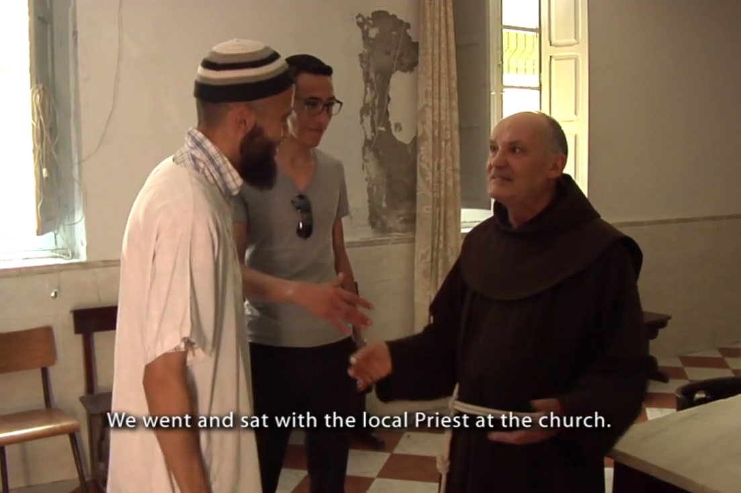
MODULE 03 | Engaging Community Leaders and Families in Countering Violent Extremism
VIDEO 4 | A Young Imam in Morocco: A Story of Bridge-Building
By: Search for Common Ground
Original Link: https://youtu.be/StMWYkepds4
https://vimeo.com/105565369
Downloadable Link: The video can be downloaded here.
Arabic Subtitles:
Advanced (recommended for use with downloaded versions)
Basic (recommended for use with YouTube)
Instructions on using these subtitles are available here.
09

Slide 10
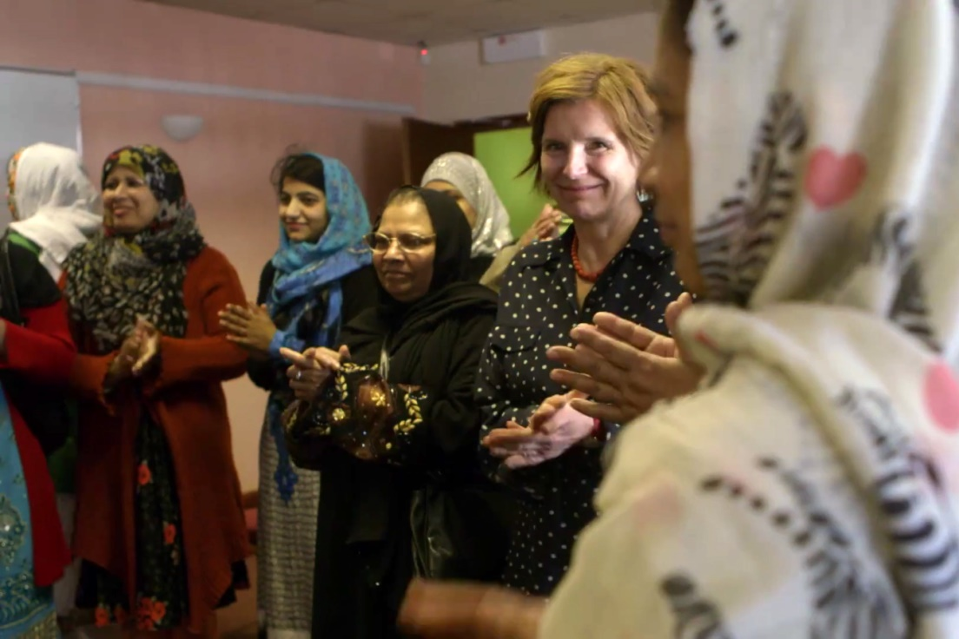
MODULE 03 | Engaging Community Leaders and Families in Countering Violent Extremism
VIDEO 5 | Mother’s School
By: Women without Borders
Original Link: https://rebrand.ly/Video05
https://youtu.be/hi6M5UGS7gA
Arabic Subtitles:
Advanced
Basic (recommended for use with YouTube)
Instructions on using these subtitles are available here.
10

Slide 11
MODULE 03 | Engaging Community Leaders and Families in Countering Violent Extremism
What are some of the potential risks of involving community leaders and family members in countering violent extremism efforts?
How can we overcome them?
11

Slide 12
MODULE 03 | Engaging Community Leaders and Families in Countering Violent Extremism
Risks of engaging communities and families in countering violent extremism programs:
Lack of a Do No Harm approach may lead to further marginalizing or discriminating against communities.
Not building the capacity of grassroots organizations may leave them without the ability to implement projects well or monitor the finances or the impact of activities.
Self-appointed community gatekeepers may require programming to be conducted narrowly through themselves.
Not recognizing the limitations of families, religious leaders, and other community leaders can lead to unfair marginalization or discrimination against them.
12

Slide 13
MODULE 03 | Engaging Community Leaders and Families in Countering Violent Extremism
KEY TAKEWAYS
Resilient communities have many defensive factors that help protect them from the rise and spread of violent extremism.
Countering violent extremism is most effective at the local level.
When government actors collaborate with local communities and listen to their needs, damaged relationships can be repaired.
13

Slide 14
MODULE 03 | Engaging Community Leaders and Families in Countering Violent Extremism
KEY TAKEWAYS
Both male and female religious leaders are important partners in countering violent extremism, but should be brought into a broader network of community leaders.
Resilient families are crucial components to communities that are resilient to violent extremism.
Local and grassroots organizations face barriers to fully participating in the countering violent extremism field.
14

