Slide 1
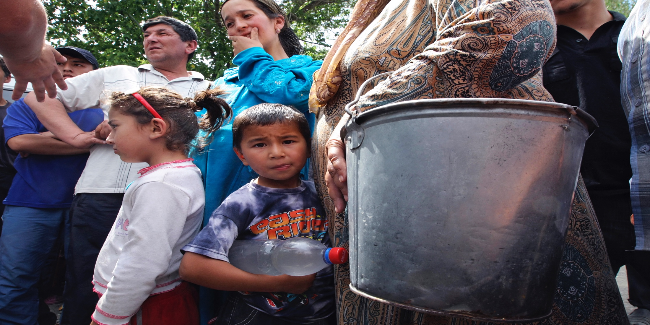
MODULE 02 Understanding Drivers of Violent Extremism in a Contextualized Manner
UN Photo/EPA

Slide 2
MODULE 02 | Understanding Drivers of Violent Extremism in a Contextualized Manner
THE QUESTIONS GAME
RULES OF THE GAME:
You can only talk in questions
You cannot repeat questions
Your question must be in response to the question you were asked
02

Slide 3
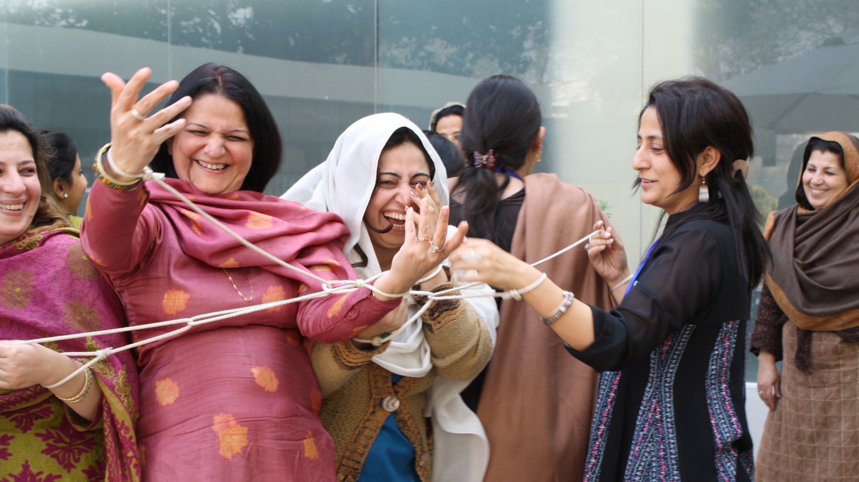
MODULE 02 | Understanding Drivers of Violent Extremism in a Contextualized Manner
DO YOU AGREE WITH THE FOLLOWING STATEMENT?
A countering violent extremism policy or program that has been successful in one context will work in another context.
03

Slide 4
Drivers of violent extremism are causes or reasons why groups or individuals might be attracted to supporting or engaging in violent extremism.
MODULE 02 | Understanding Drivers of Violent Extremism in a Contextualized Manner
04

Slide 5
MODULE 02 | Understanding Drivers of Violent Extremism in a Contextualized Manner
VIDEO 2 | Preventing violent extremism through education
By: UNESCO
Original Link: https://youtu.be/79MTkVumCcQ
Downloadable Link: The video can be downloaded here.
Russian Subtitles:
Advanced (recommended for use with downloaded versions)
Basic (recommended for use with YouTube)
Instructions on using these subtitles are available here.
05

Slide 6
MODULE 02 | Understanding Drivers of Violent Extremism in a Contextualized Manner
Factors of radicalization
Push factors are any condition or grievance that creates a sense of frustration, marginalization, and disempowerment which encourage people to seek out remedies including, but not limited to, joining extremist groups.
Group dynamics and relationships are factors that shape the issues, environment, and community in ways that make individuals or communities more vulnerable to violent extremism.
Pull factors are forces that can be attractive to potential recruits and specifically draw them into radical organizations, such as a sense of kinship, heroism, adventure, economic gain or self-realization.
06

Slide 7
MODULE 02 | Understanding Drivers of Violent Extremism in a Contextualized Manner
Guiding Questions on the Drivers of Violent Extremism
What is the risk of violent extremism in your context and what are its forms?
Why are people drawn to violent extremism?
Who is being drawn to violent extremism?
Where are people being drawn to violent extremism?
How are people being radicalized?
07

Slide 8
MODULE 02 | Understanding Drivers of Violent Extremism in a Contextualized Manner
VIDEO 3 | The Promises of ad-Dawlah to Women
By: The International Center for the Study of Violent Extremism (ICSVE)
Original Link: https://youtu.be/Ed99vbD7Lr8 [Russian]
https://youtu.be/qZknfoA-O2k [English]
08

Slide 9
MODULE 02 | Understanding Drivers of Violent Extremism in a Contextualized Manner
Guiding Questions on the Drivers of Violent Extremism
What is the risk of violent extremism in your context and what are its forms?
Why are people drawn to violent extremism?
Who is being drawn to violent extremism?
Where are people being drawn to violent extremism?
How are people being radicalized?
09

Slide 10
MODULE 02 | Understanding Drivers of Violent Extremism in a Contextualized Manner
What are some risks of researching violent extremism?
10

Slide 11
MODULE 02 | Understanding Drivers of Violent Extremism in a Contextualized Manner
Avoiding risks and pitfalls of research
Be conscious of how your research team may be perceived by participants and ensure their security.
Participants must feel comfortable enough to participate and to give more accurate responses.
Be particularly cautious when involving children in research.
Have clear definitions and be consistent with their use.
11

Slide 12
MODULE 02 | Understanding Drivers of Violent Extremism in a Contextualized Manner
Avoiding risks and pitfalls of research
Be appropriately skeptical of what you are told by respondents.
Be realistic about what your findings tell you and how far you can draw conclusions from them.
Be transparent regarding your methodology and the limitations of your research when sharing it.
12

Slide 13
MODULE 02 | Understanding Drivers of Violent Extremism in a Contextualized Manner
KEY TAKEWAYS
Violent extremism and radicalization are highly context-specific.
Violent extremism and radicalization are complex issues, but we have learned a lot about them that are helpful in guiding countering violent extremism programs and policies.
Preventing and countering violent extremism policies and programs are more effective when they are built on evidence based research.
Safety and security are critical when studying violent extremism.
13

