Slide 1
MODULE 01 Conceptual Grounding in Countering Violent Extremism

Slide 2
Evgeni Zotov/CC BY-NC-ND 2.0
MODULE 01 | Conceptual Grounding in Countering Violent Extremism
01
How would you define terrorism?
02
How would you define violent extremism?
03
How do you think that different definitions can affect working on these problems in your local context?
02

Slide 3
MODULE 01 | Conceptual Grounding in Countering Violent Extremism
What is countering violent extremism and how is it related to counter-terrorism?
Countering violent extremism refers to the programs and policies which aim to dissuade individuals or groups from radicalization and recruitment into violent extremism and resorting to ideologically motivated violence to further social, economic, religiously-based or political objectives.
03

Slide 4
MODULE 01 | Conceptual Grounding in Countering Violent Extremism
What is Counter-Terrorism?
Counter-terrorism is the realm of coercive and non-coercive programs and policies to prevent and deny opportunities for violent extremist activity and to disrupt, arrest, prosecute, and/or kill violent extremist groups and individuals. Traditional, coercive, and forceful counter-terrorism measures are usually limited to government actors, such as the security forces or the military, but may include other institutions.
04

Slide 5
MODULE 01 | Conceptual Grounding in Countering Violent Extremism
How confident are you that after five years of our current countering violent extremism strategy that we will have ended the threat of violent extremism?
05

Slide 6
MODULE 01 | Conceptual Grounding in Countering Violent Extremism
What are some critiques of countering violent extremism in your context?
06

Slide 7
MODULE 01 | Conceptual Grounding in Countering Violent Extremism
Countering violent extremism has been criticized for:
marginalizing target communities,
instrumentalizing communities rather than empowering them,
securitizing other important efforts,
an inability to measure success or what works, or
simply masquerading other fields or kinds of programs as “countering violent extremism”
07

Slide 8
A Do No Harm approach is the practice of understanding how countering violent extremism efforts interact with local dynamics and relationships to allow practitioners to mitigate or avoid negative, unintended consequences that may result from these efforts and to focus on positively influencing these dynamics and relationships.
MODULE 01 | Conceptual Grounding in Countering Violent Extremism
08

Slide 9
MODULE 01 | Conceptual grounding in countering violent extremism
VIDEO 1 | Countering Violent Extremism in Los Angeles
By: The Los Angeles Interagency Coordination Group
Original Link: https://youtu.be/YPM3M5qee7M
Downloadable Link: The video can be downloaded here.
Russian Subtitles:
Advanced (recommended for use with downloaded versions)
Basic (recommended for use with YouTube)
Instructions on using these subtitles are available here.
09

Slide 10
MODULE 01 | Conceptual grounding in countering violent extremism
How is Los Angeles’ experience similar or different to your local context?
10

Slide 11
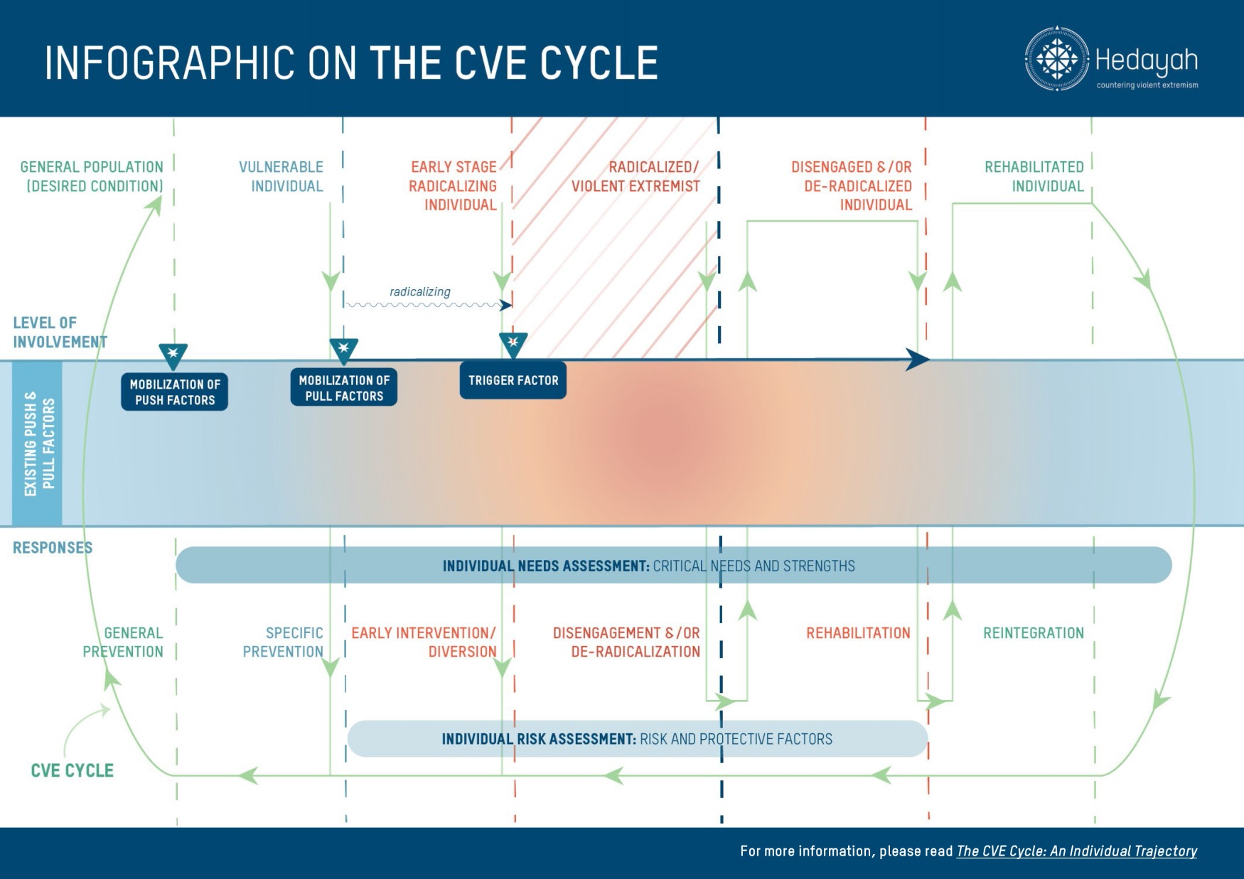
11

Slide 12
MODULE 01 | Conceptual Grounding in Countering Violent Extremism
KEY TAKEWAYS
Violent extremism is a complex problem, but is not a “phenomenon” that is impossible to understand or address.
Preventing and countering violent extremism requires a broad approach with multiple tools.
Violent extremism is very context-specific and cannot be associated with any religion, nationality, or ethnic group.
12

Slide 13
MODULE 01 | Conceptual Grounding in Countering Violent Extremism
KEY TAKEWAYS
How we define violent extremism and other terms is important.
Countering violent extremism requires the involvement of the whole society.
There may be costs of failure when countering violent extremism programs do not work.
13

